Slide 1

GAME THEORY PROJECT
Armaan Khetarpaul
Varivashya Poladi

Slide 2
The Idea
No guesses or tricks
Raw brute force!
Need to find (a) best move for a given position.
Each move branches out into several variations (large but small enough for a 3x3 tic-tac-toe)
From the tree, pick the branch with best possible outcomes.

Slide 3
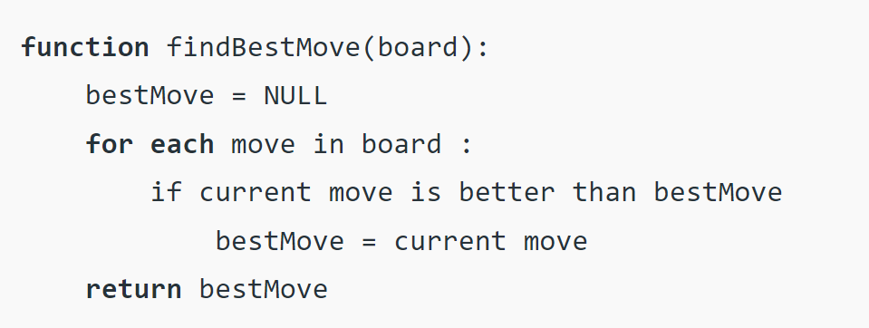

Slide 4
How to find best move?
Use minimax() algorithm.
Backtracking algorithm
Every position is given a score (evaluation) (Guaranteed win=+Infty, guaranteed loss=-Infty)
Two players: maximiser and minimiser
The maximizer tries to get the highest score possible while the minimizer tries to do the opposite and get the lowest score possible.

Slide 5
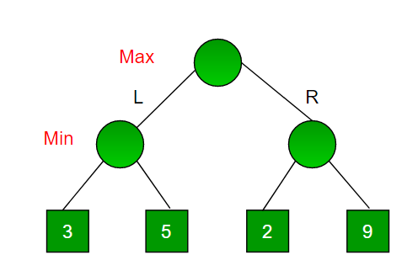

Slide 6
Minimax Function
3 parameters:
Current position
Depth (how far to go)
Turn
Problem: How to give a score to the board, i.e., How to evaluate the position mathematically?

Slide 7
Simple UI
We’ll begin with a simple working UI of a board using a 3x3 array.
x-> cross
o-> circle
Implementation of the algorithm will decide module for final UI.

